Slide 1



A SMART WEB APP FOR BOOKSTORE MANAGEMENT
Nguyen Thi Kim Thu
Supervisor: Assoc. Prof. Nguyen Van Sinh

Slide 2
01.
REQUIREMENT
02.
PROBLEM STATEMENT & OBJECTIVES
03.
SYSTEM DESIGN
04.
IMPLEMENTATION AND RESULT
05.
EVALUATION & FUTURE WORK
TABLE OF
CONTENT
06.
CONCLUSION

Slide 3
PROBLEM STATEMENT
& OBJECTIVES
Poor personalization in online bookstores
Inefficient inventory & revenue tracking

Slide 4

OBJECTIVES
Smart recommendation
Automated inventory & order management
Enhanced customer & seller experience

Slide 5
REQUIREMENT
Funtional requirement
Non-funtional requirement

Slide 6

FUNTIONAL REQUIREMENT
User registration, login, authentication
Product management (CRUD)
Shopping cart & checkout process
Order management
Product recommendation system
Price suggestion system
Advanced product filtering (price, rating,...)
Notifications for store owners
Customer product reviews
Profile management (address, phone)

Slide 7
NON-FUNTIONAL REQUIREMENT
Responsive UI (Next.js)
API response time < 300ms
Secure authentication (JWT, bcrypt)
Scalable & maintainable architecture

Slide 8
SYSTEM DESIGN
Funtional requirement
Non-funtional requirement

Slide 9
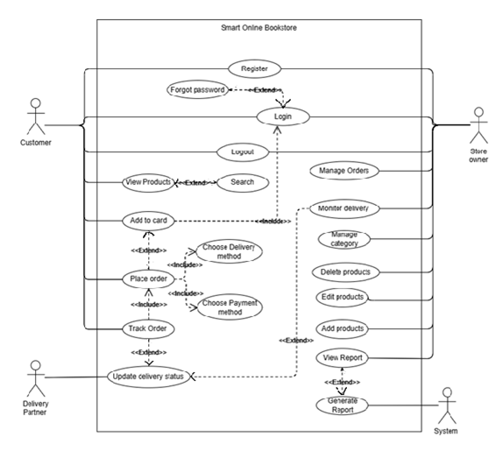
USE CASE DIAGRAM
Customer Use Cases:
Register/Login
Search & Filter Products
Add to Cart
Checkout & Place Order
Review Products
Manage Profile

Slide 10
USE CASE DIAGRAM
Store Owner Use Cases:
Manage Products
View Orders
Receive Notifications (New Orders, Low Stock)
View Dashboard

Slide 11





TECHNOLOGY USED
Frontend: Next.js
Backend: Node.js + Express
Database: MySQL
API: Google Books
Auth: JWT, bcrypt

Slide 12
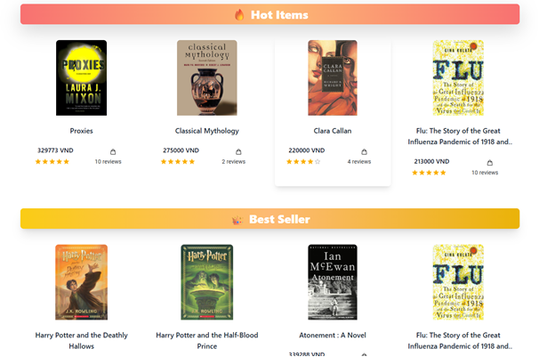
MAIN FEATURES
Recommendation System
Based on: Clicks, Sold
Features: Hot Items, Best Sellers, Related Products, Book of the Day
Data: customer_tag_scores table
Future: Integrate AI/ML

Slide 13
MAIN FEATURES
Evaluation of the Recommendation System
Metrics used: Precision@k, Recall@k
Data sources: recommended_logs (System's predictions), ground_truth_logs (Actual user interactions)

Slide 14
MAIN FEATURES
Flow
For each user:
Get top-k recommended products.
Get real interacted products.
Compute precision & recall.
Average over all users.
Additional action stats from logs.

Slide 15
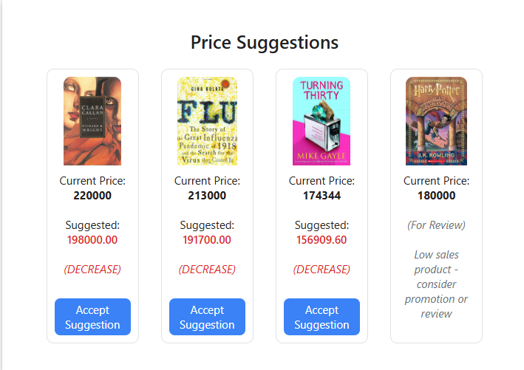
MAIN FEATURES
Price suggestion system
Revenue Management, Demand-Based Pricing
Metrics: Conversion Rate, Revenue Difference
Auto price suggestion: remove discount
Saved in price_suggestions table

Slide 16
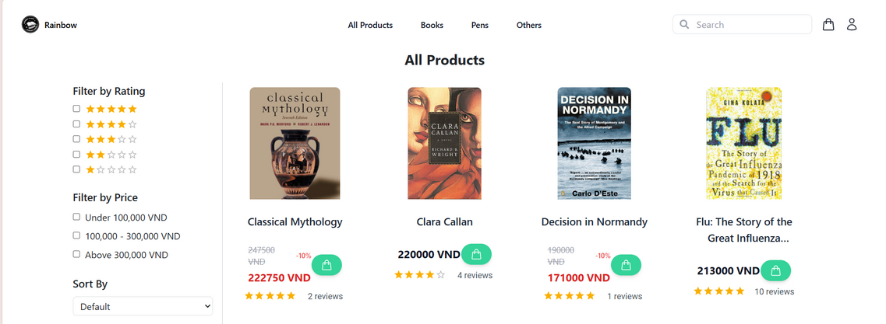
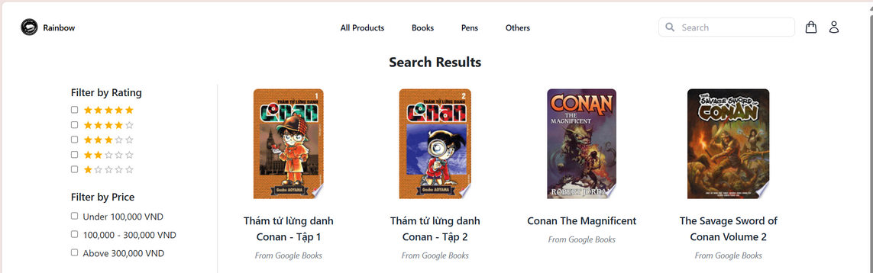
MAIN FEATURES
Advanced Search & Filter
Filters: Price, Rating, Clicked, Sold, Tags
Smart search (fallback: Google Books API)
Real-time filter without page reload

Slide 17
]IMPLEMENTATION
& RESULTS
Backend: 20+ REST APIs
Frontend: Next.js, Tailwind CSS, MUI

Slide 18
STORE OWNER
CRUD Products
Notifications: new orders, low/out of stock
Real-time Dashboard
CUSTOMER
Account Info Edit
Product Review (after successful order)
Complete purchase flow

Slide 19
DEMO

Slide 20
EVALUATION & FUTURE WORK
90% objectives achieved
Limitations: No payment gateway yet

Slide 21
Future Plans:
Momo/VNPay Integration
Mobile App
AI Recommendation
Dynamic Pricing Automation

Slide 22
CONCLUSION

Slide 23
Extra Features Highlight
Authentic Product Review (post-purchase)
Dynamic Notifications for Store Owner
Account Management (address, phone)
Complete Purchase Workflow
Advanced Filtering & Search

Slide 24
REFERENCES
1. Baeldung. (2024). Amazon recommendation system.
https://www.baeldung.com/cs/amazon-recommendation-system
2. Amazon Science. (2019). The history of Amazon's recommendation algorithm.
https://www.amazon.science/the-history-of-amazons-recommendation-algorithm
3. Stratoflow. (2024). Amazon recommendation system.
https://stratoflow.com/amazon-recommendation-system
4. Evdelo. (2020). Amazon’s recommendation algorithm drives 35% of its sales.
https://evdelo.com/amazons-recommendation-algorithm-drives-35-of-its-sales
5. Seller Mobile. (2023). Amazon inventory management guide for 2023: Manage stock like a pro.
https://sellermobile.com/amazon-inventory-management-guide-for-2023-manage-stock-like-a-pro

Slide 25
REFERENCES
6. Business Model Analyst. (2024). Amazon SWOT analysis.
https://businessmodelanalyst.com/amazon-swot-analysis/
7. Wired. (2021). Amazon failed to protect your data: Investigation.
https://www.wired.com/story/amazon-failed-to-protect-your-data-investigation/
8. Tiki Engineering. (2021). Using approximate nearest neighbor for faster retrieval on recommendation system.
https://engineering.tiki.vn/using-approximate-nearest-neighbor-for-faster-retrieval-on-recommendation-system/
9. Google Cloud.Tiki: Google Cloud customers.
https://cloud.google.com/customers/tiki-en

Slide 26
REFERENCES
10. Google Books API: Google. (n.d.). Google Books APIs.
https://developers.google.com/books
11. Amazon: Amazon. (n.d.). Amazon.com Official Site.
https://www.amazon.com
12. Kaggle Dataset - Books Dataset by Saurabh Bagchi: Bagchi, S. (2020). Books Dataset.
https://www.kaggle.com/datasets/saurabhbagchi/books-dataset

Slide 27
THANK YOU
Do you have any question?

